Slide 1
Big Data Analytics
King County Housing Prices
Project Presentation
Team Members- Tejashri Joshi, Surbhi Goyal

Slide 2
Problem
Create a predictive model for home prices based on given data.
Motivation
Helpful for real estate agents.
Helpful for the people who are interested in buying home.

Slide 3
Data Set
Data given is about all the houses sold in king county area in the period of May 2014 to May 2015.
Taken from Kaggle in csv format.
Data set includes various aspects related to home selling.

Slide 4
Methodology
Understanding of data
Data Transformation And EDA
1. Missing Data
2. Outlier Detection
3. Correlation Matrix and feature selection
Implementation of ML models
Evaluation and Comparison of methods (Cross validation & A/B testing)

Slide 5
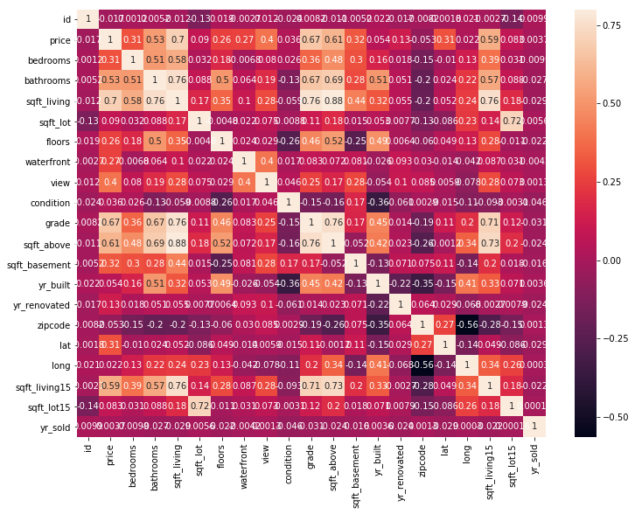
Correlation Matrix
Columns having highest correlation with price
Grade
sqft_living
sqft_above
sqft_living15

Slide 6
Models Implementation
Models:
Linear Regression
Gradient Boosting - Boosting
Random Forest - Bagging
Hyper parameter tuning for Gradient Boot and Random Forest :
n_estimators = 300
max_depth = 4
learning Rate = 0.01
min_sample_split = 2
max_features = 4

Slide 7
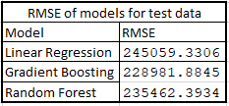
Experiment-1
Evaluation Metric
Root Mean Square Error
RMSE values for implemented models for 80-20 split of train and test data

Slide 8
Experiment-2
Cross validation and A/B testing:
Used k-fold cross validation with 5 folds
Calculated p value to compare the methods using the cross val scores of each method
Model | Negative Mean Square Error
Linear Regression | -56890810660.636452
Gradient Boosting | -48732639597.703529
Random Forests | -53419707700.304329

Slide 9
Experiment -3
 | Gradient Boosting
Linear Regression | P-Value
 | 0.027066585661775347
 | Linear Regression | Gradient Boosting
Random Forests | P-Value | P-Value
 | 0.2907961770710954 | 0.11710502857497124

Slide 10
Conclusion
When compared linear regression and gradient boosting-
As p value is less we can reject null hypothesis. We can conclude gradient boosting is better than linear regression.
When compared random forest with linear regression and gradient boosting-
As p value is large, we can not reject null hypothesis.
Gradient Boost model performs slightly better than Linear Regression and Random Forest.

Slide 11


